Slide 1
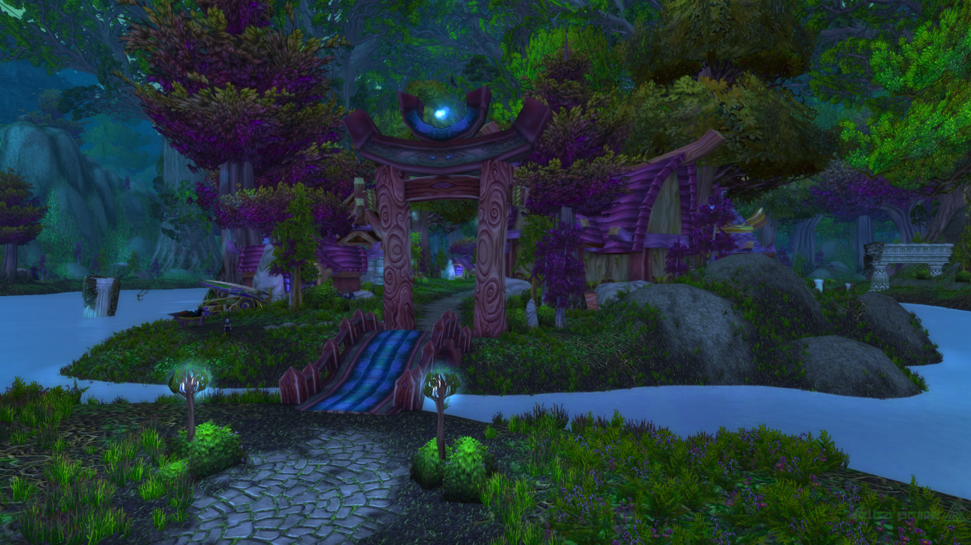
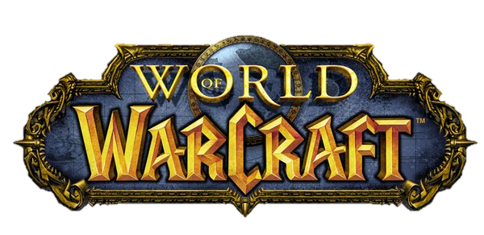
How became international
By: Jakub Pažej (18260179)
CS4093

Slide 2
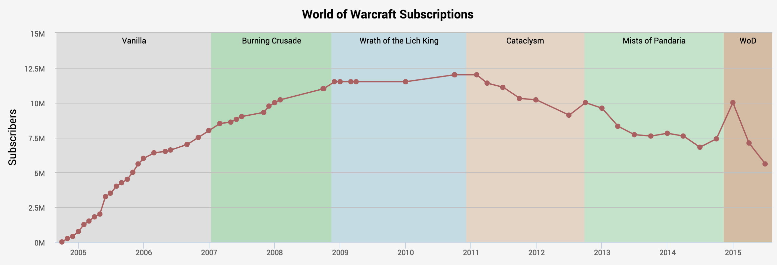
Some History:
MMORPG released in 2004, EU 2005
3 previous Warcraft universe games
Azeroth
100mil accounts in 2014

Slide 3
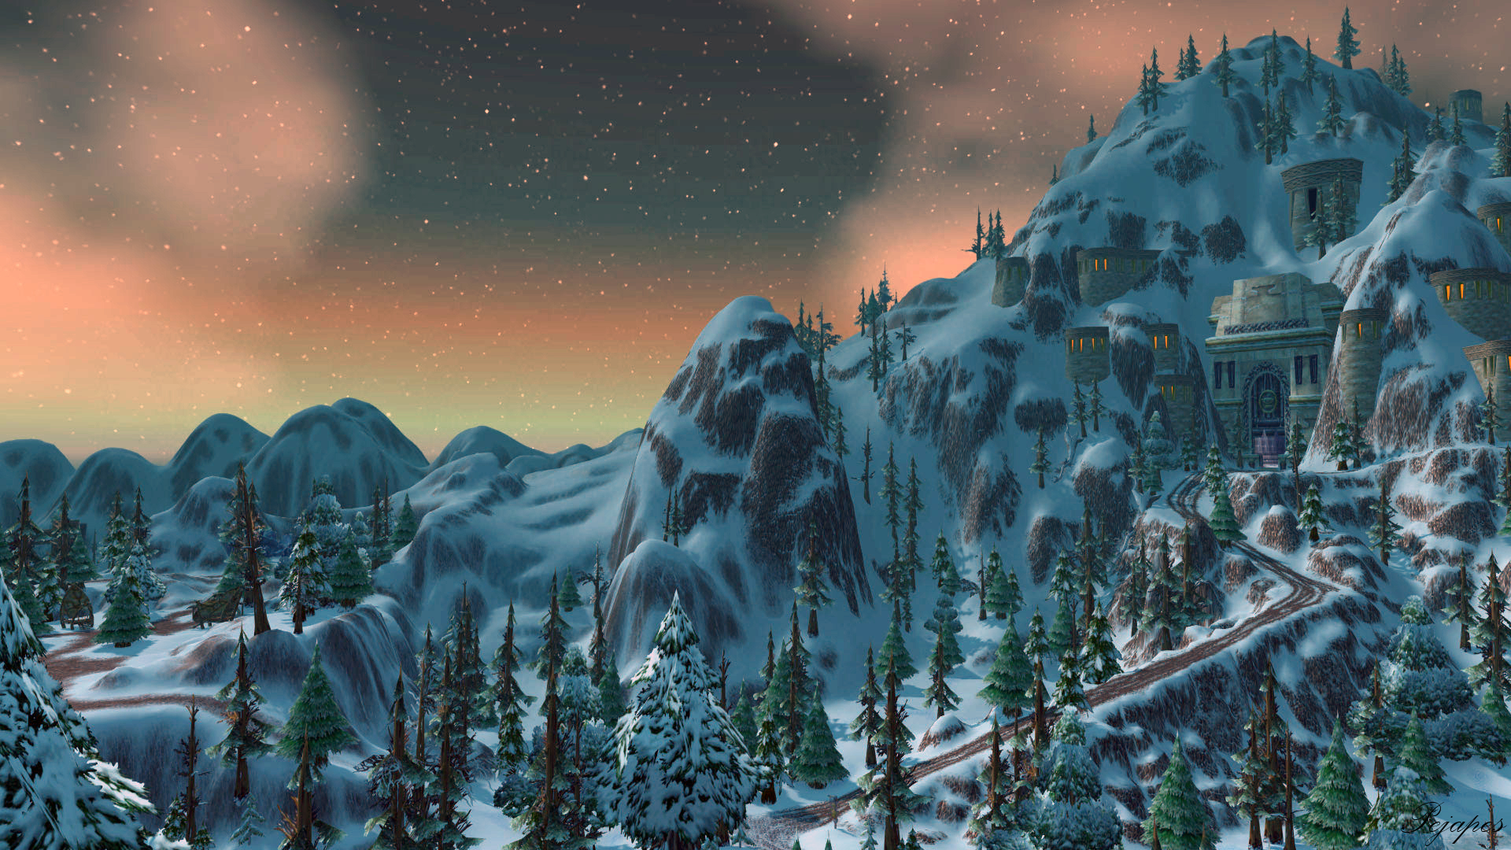
Gameplay
Character, faction, race, class, professions
Type of server
Multiple gameplay and levelling options
Lore: Chris Metzen, cannon and non-cannon solution

Slide 4
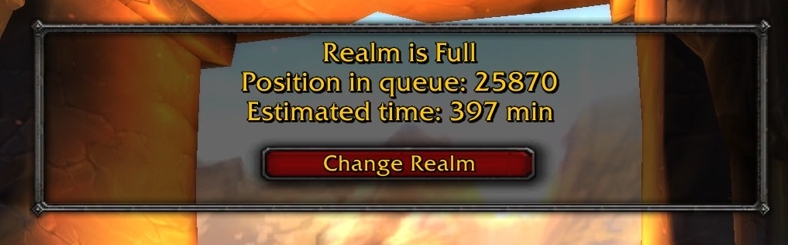
Launch Day
Much higher number of people than expected
Unstable servers
Opening of multiple new realms to handle it
Midnight Sales
Classic WoW today

Slide 5
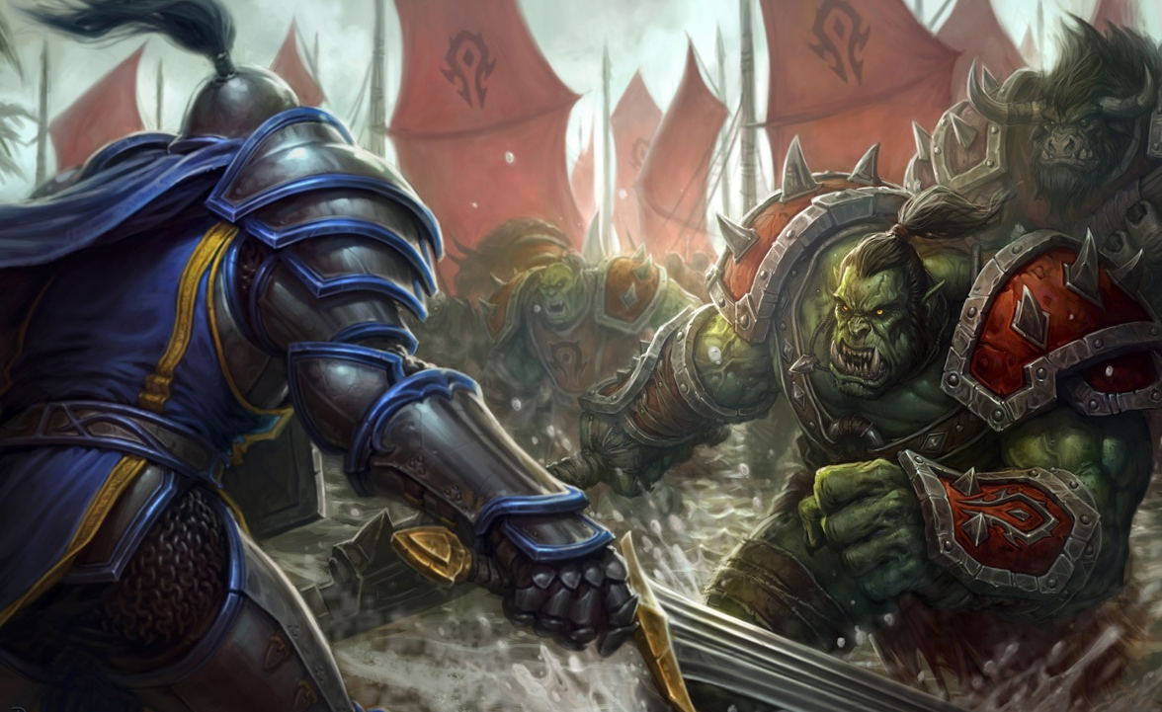
Regional Marketing Differences
USA, Canada and EU (physical game, sub)
Brazil (2011, 3 translated)
South Korea (no physical copies and weird sub types)
China(prepaid cards, keys)

Slide 6
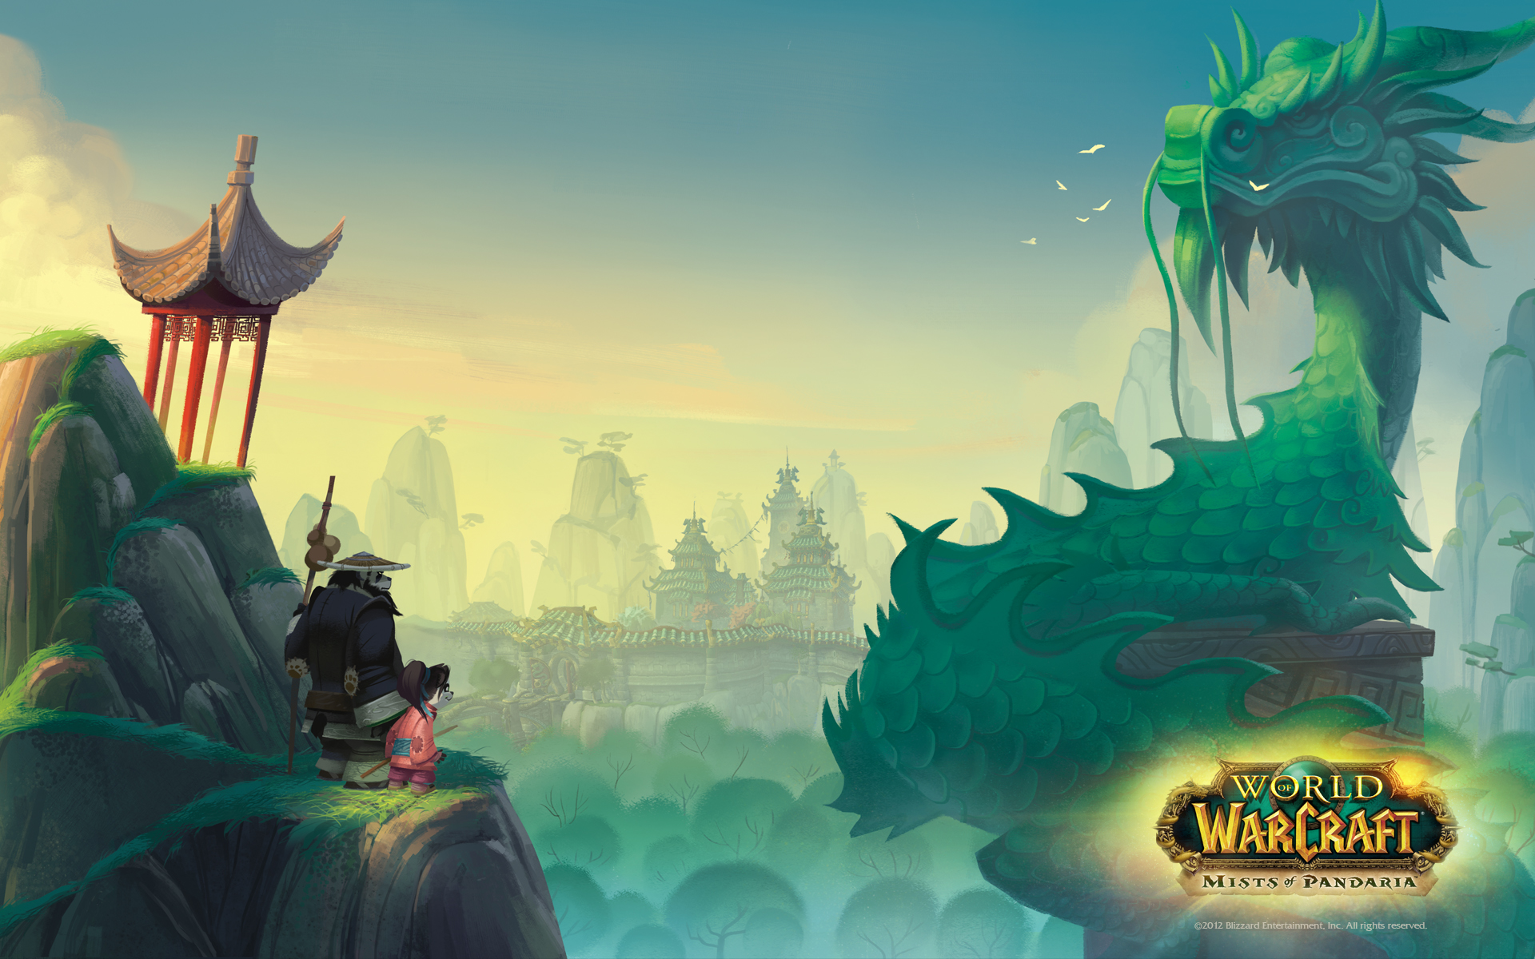
Chinese version
Anything with death or representing death is a taboo
No skulls, bones or undead
Death knight class = fade knight, all the abilities containing death are renamed to fade.
some of the undead variations actually look nice and I think would be nice as an appearance option for other countries

Slide 7
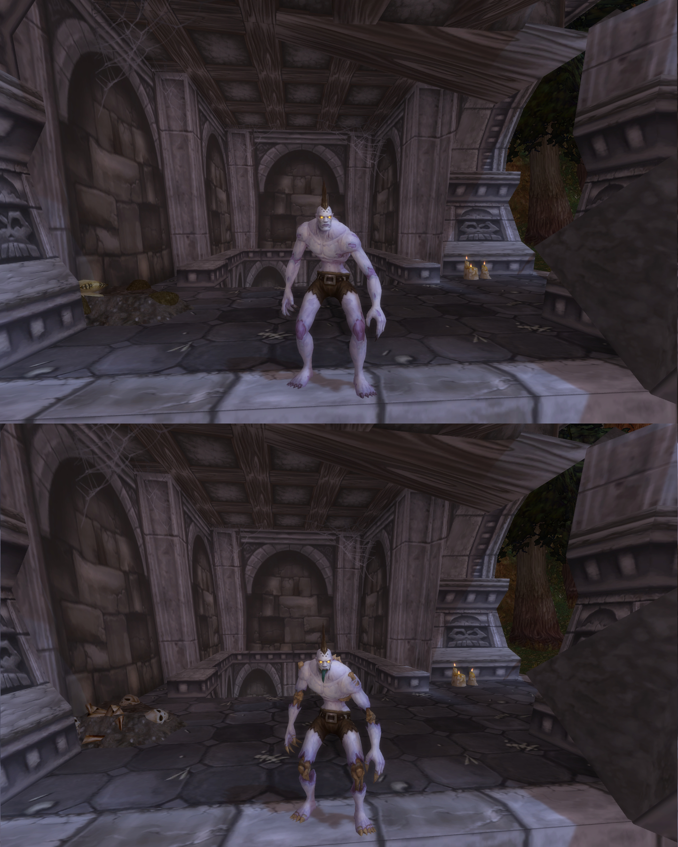
Chinese version

Slide 8
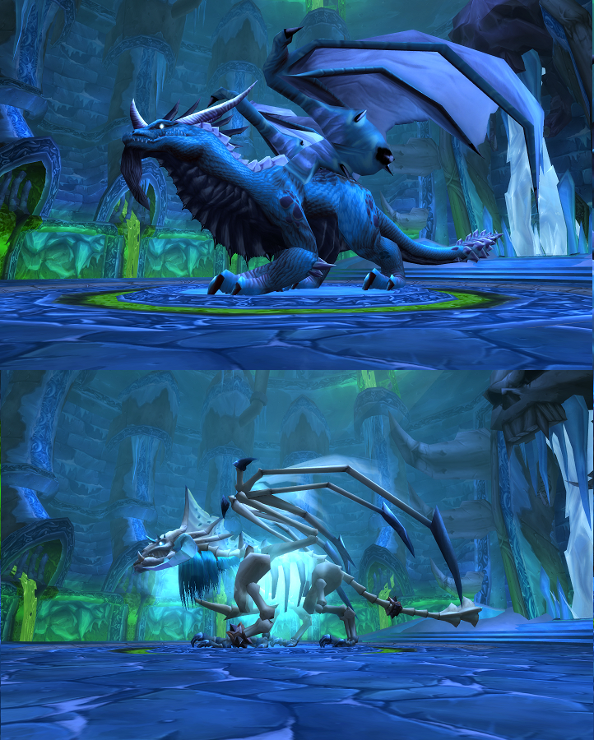

Slide 9
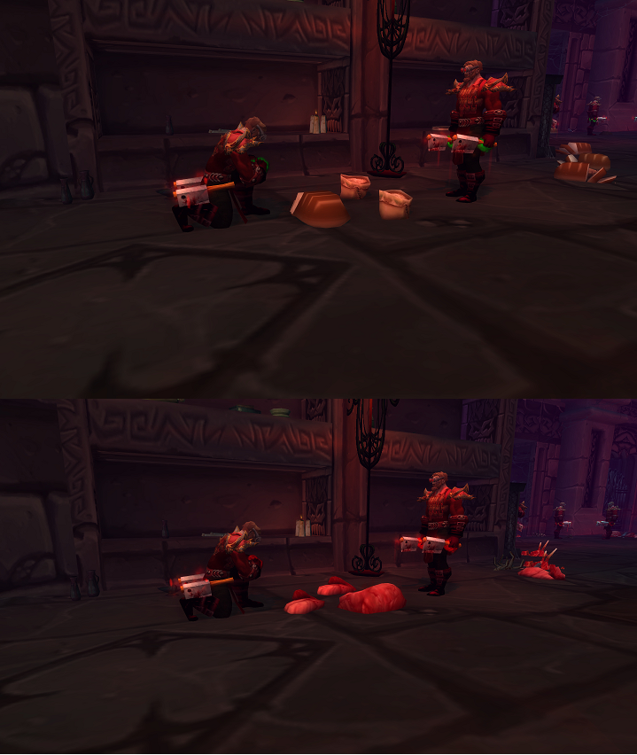
THE BREADENING

Slide 10
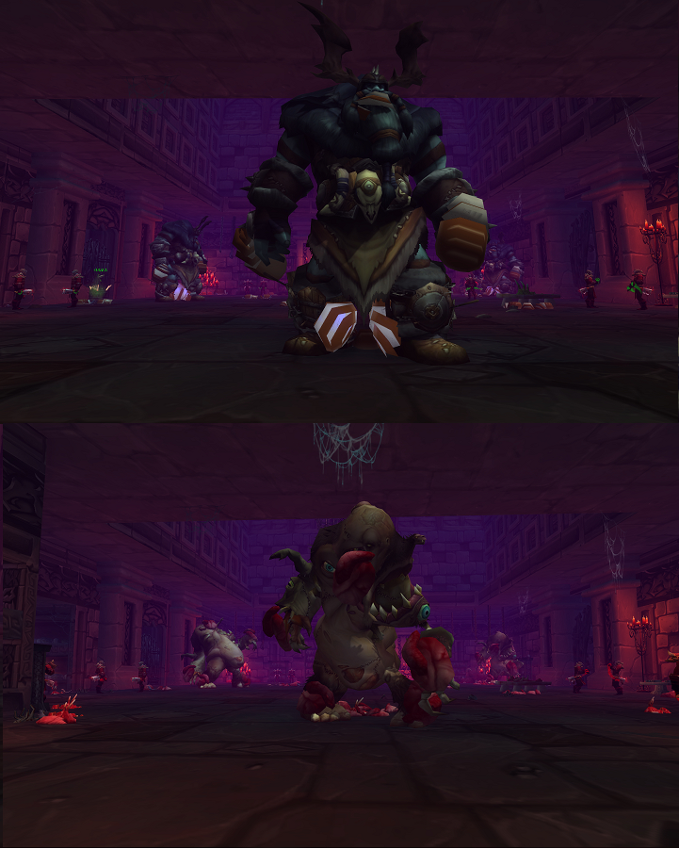

Slide 11
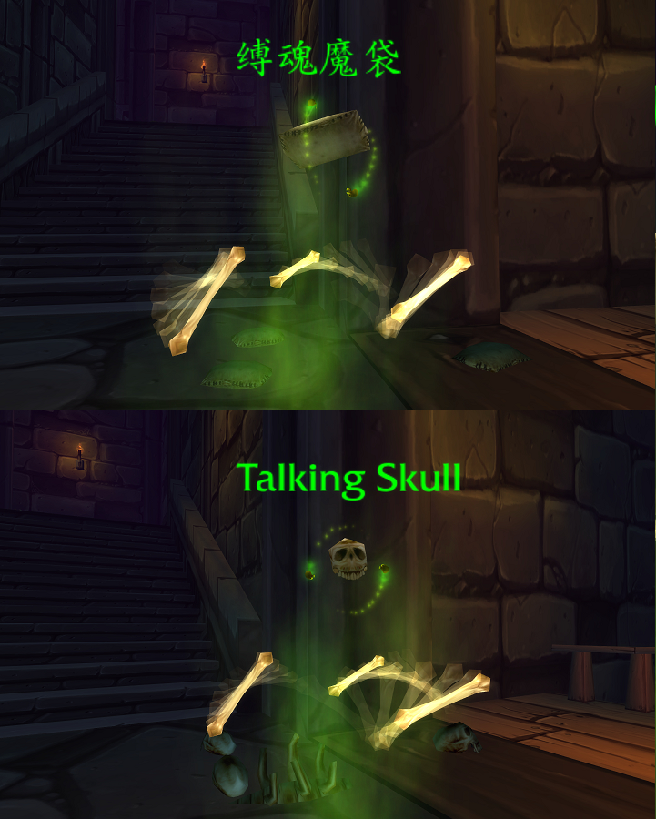
Spooky sack of grain

Slide 12
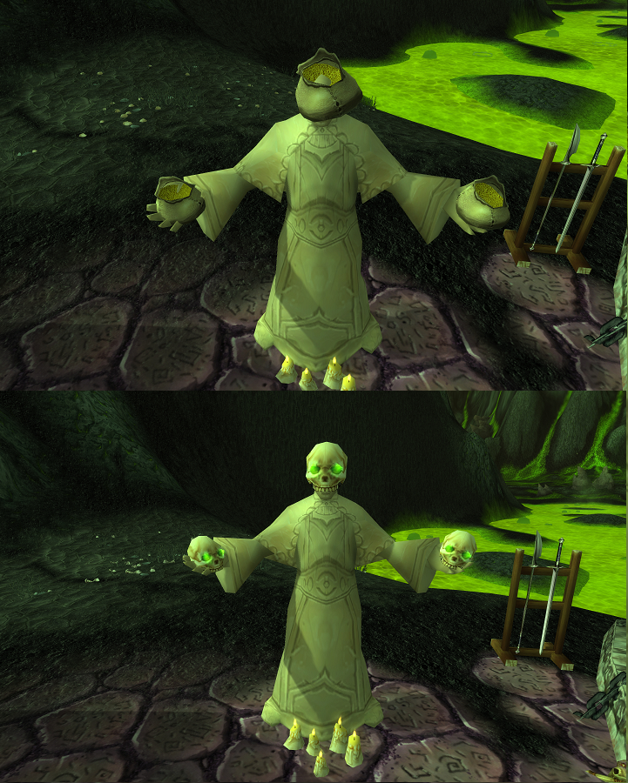
Unholy grain statue

Slide 13
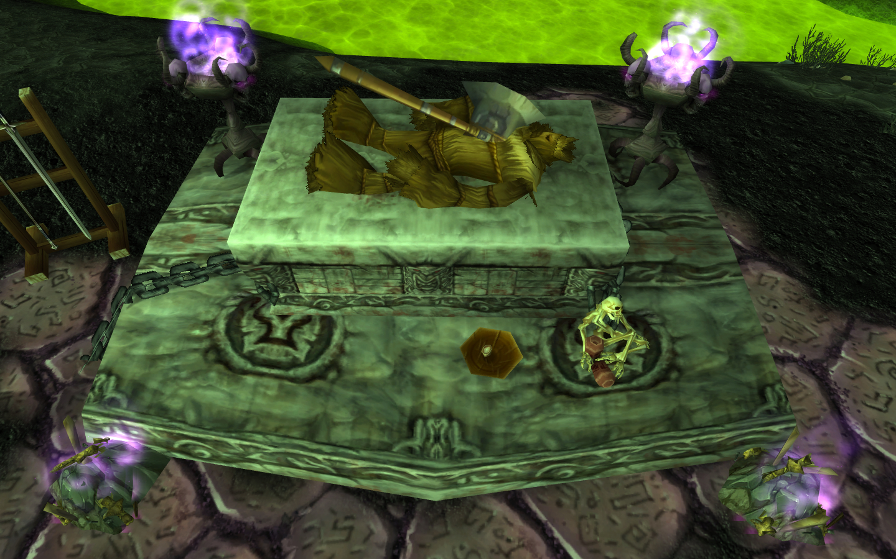

OOH NYOOO Mr. Strawman

Slide 14
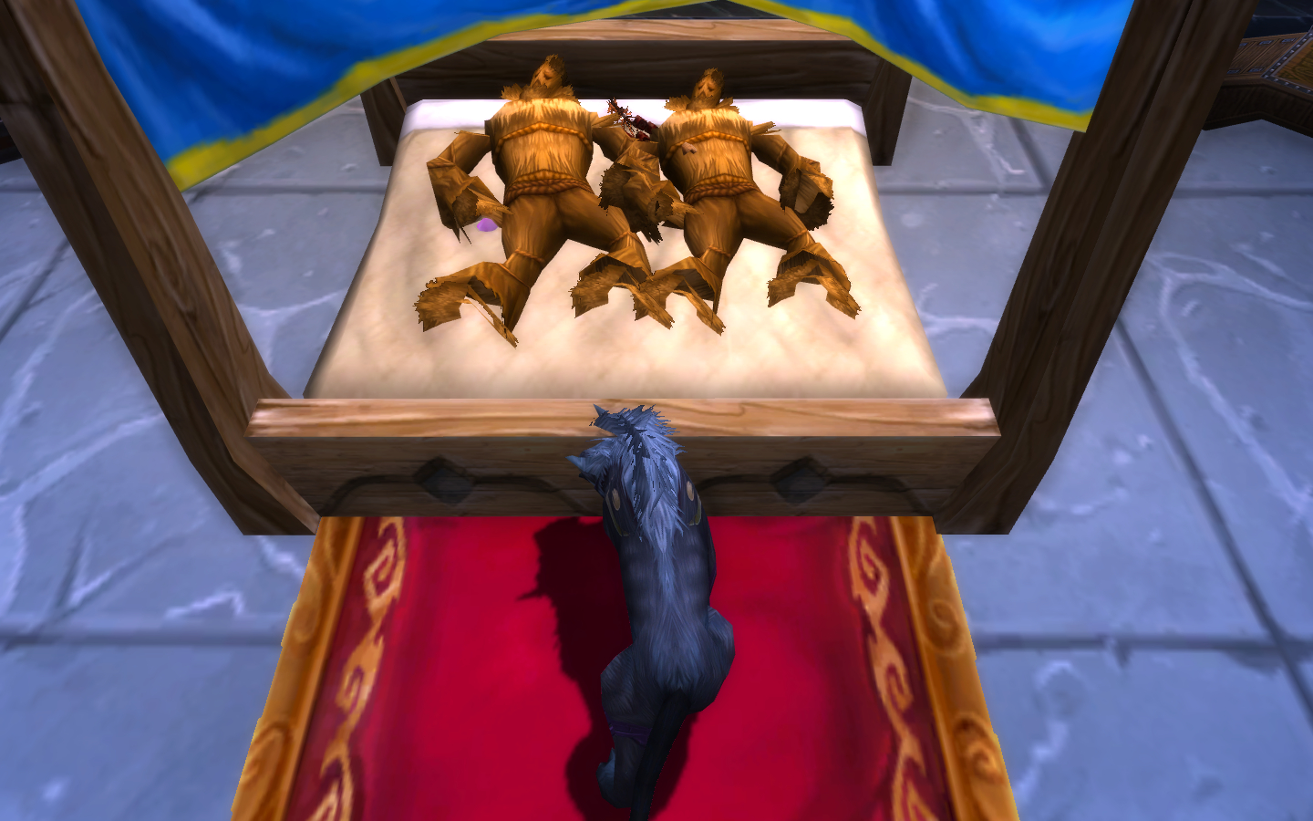

Slide 15


Storytime!
https://www.youtube.com/watch?v=izCBaGfGJCg&feature=youtu.be&t=9045
Moral of the Story

Slide 18
References
wikipedia.org/wiki/World_of_Warcraft
Multiple youtube videos
blizzard.com

Slide 19
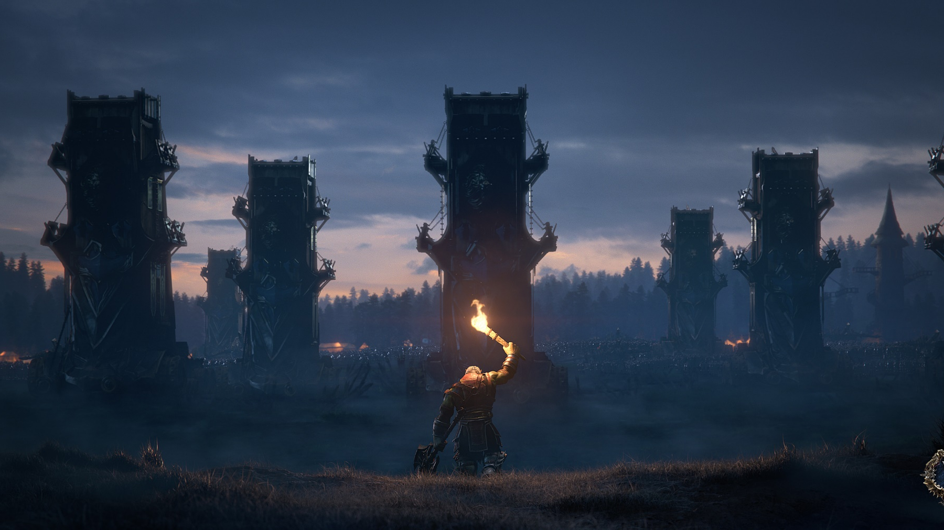
Thanks for your attention :)

